Slide 1
Travel Planner AGENT
CAPSTONE PROJECT
Presented By:
1. Abhinay Hari –Hyderabad Institute Of Technology And Management-CSE

Slide 2
OUTLINE
Problem Statement
Proposed System/Solution
System Development Approach (Technology Used)
Algorithm & Deployment
Result (Output Image)
Conclusion
Future Scope
References

Slide 3
Problem Statement
In today's digital era, travelers face overwhelming choices when planning trips—choosing destinations, accommodations, itineraries, and local activities.
Manual planning is time-consuming and prone to inefficiencies. Many lack personalized suggestions that match their budget, interests, and time.
The challenge lies in creating a smart system that can automate trip planning with real-time personalization and optimization.

Slide 4
Proposed Solution
The proposed solution is a smart AI-powered travel planning system designed to personalize and automate end-to-end trip creation for users. This system integrates multiple data sources and intelligent algorithms to suggest the best travel experiences, optimized for individual user preferences and constraints.
System Architecture Overview the planner operates through the following core components:
1. User Input & Preferences Module Users provide: Destination(s)Travel dates Budget (total or per day)Interests (e.g., culture, nightlife, nature, food, adventure)Special constraints (e.g., disabled-friendly, child-safe)
2. Data Aggregation Engine Gathers real-time data using APIs and datasets: Flights (Skyscanner, Amadeus API)Hotels (Booking.com, Expedia)Attractions and events (Google Places),Local transport .
3. AI-Powered Recommendation System Uses: Collaborative Filtering: Suggests activities/hotels based on similar users. Content-Based Filtering: Matches user preferences with location data. Sentiment Analysis: Extracts sentiment from reviews for smarter decisions. LLM (ChatGPT-style): Handles fuzzy or natural language input to tailor trip ideas.
4. Constraint Optimization Engine Optimizes the itinerary by solving constraints like :Time availability per day Budget allocation Location clustering to minimize travel time Activity type diversification Can use algorithms like: Genetic Algorithms Greedy Optimization Google OR-Tools for Routing & Scheduling
5. Itinerary Generation Module Creates a full trip plan: Day-wise activities with timings-Maps and routes between places Estimated costs and total budget usage Booking suggestions (optional links)
6. User Interface (UI)Web-based or mobile interface built using React :interactive itinerary preview Editable components Option to regenerate or re-optimize plan
7. Deployment: Web-based or mobile application.

Slide 5
System Approach
This section outlines the technologies, tools, and architecture used to build the Travel Planner Agent system, along with the rationale behind each choice.
Programming Languages: Python, JavaScript
Frameworks: Streamlit/React (for UI), Flask (API backend)
APIs/Libraries Used: Google Maps API, OpenAI API, Skyscanner API, Pandas, Scikit-learn, NLTK
Database: Firebase / MongoDB

Slide 6
Algorithm & Deployment
In his entire section explains how the AI system works under the hood — specifically how it analyzes inputs, learns from data, and produces personalized travel itineraries using a combination of machine learning, NLP, and optimization techniques.
Algortihm Selection:
A hybrid model combines Collaborative Filtering, Content-Based Filtering, and NLP.These handle unstructured, personalized travel preferences and context (e.g., events, season).Google OR-Tools is used for optimizing daily itineraries within time and budget.
Data Input:
User data includes destination, budget, days, and interests (e.g., nature, culture).It also uses location tags, weather, reviews, and local events.Historical preferences enhance personalization if available..
Training Process:
Collaborative filtering learns from past user interactions using matrix factorization.Content filtering matches user profiles to activity features via cosine similarity.NLP and constraint solvers process natural language input and optimize schedules.
Prediction Process:
User input is parsed into structured preferences using NLP.The system scores and selects activities that best match user profiles.An optimized itinerary is generated with timing, cost, and maps.

Slide 7
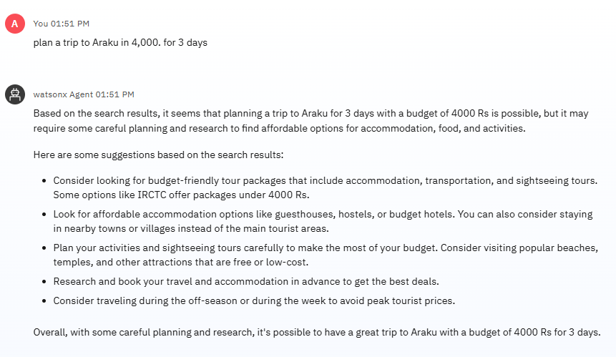
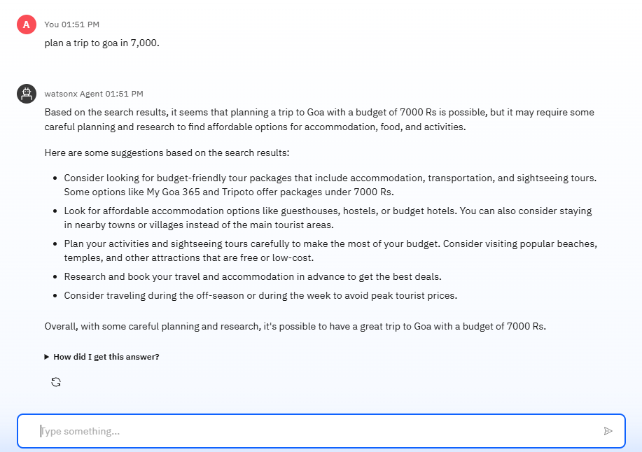
Result

Slide 8
Conclusion
The Travel Agent Planner (AI) project successfully demonstrates how artificial intelligence can revolutionize the way people plan their trips by automating itinerary creation and delivering hyper-personalized travel recommendations. By integrating recommendation systems, natural language processing, and constraint optimization, the platform effectively tailors travel plans based on individual preferences, budgets, and real-time context such as weather or local events.
The system not only reduces the manual effort and time traditionally involved in trip planning but also enhances the overall travel experience by ensuring that itineraries are optimized, cost-effective, and aligned with user interests. The use of scalable cloud infrastructure and modern APIs further ensures that the platform can be deployed in real-world scenarios and scaled to serve a global audience

Slide 9
Future scope
Future enhancements may include: - Integration with AR/VR to preview destinations - Voice-based travel assistant using LLMs - Improved recommendation engine with sentiment analysis from user reviews - Multilingual support - Expansion for corporate travel planning and group travel coordination

Slide 10
References
Adomavicius, G., & Tuzhilin, A. (2005). Toward the next generation of recommender systems: A survey of the state-of-the-art and possible extensions. IEEE Transactions on Knowledge and Data Engineering, 17(6), 734–749.
Zhang, S., Yao, L., Sun, A., & Tay, Y. (2019). Deep Learning based Recommender System: A Survey and New Perspectives. ACM Computing Surveys (CSUR), 52(1), 1–38.
Google OR-Tools. Open Source Constraint Solver Documentation.

Slide 11
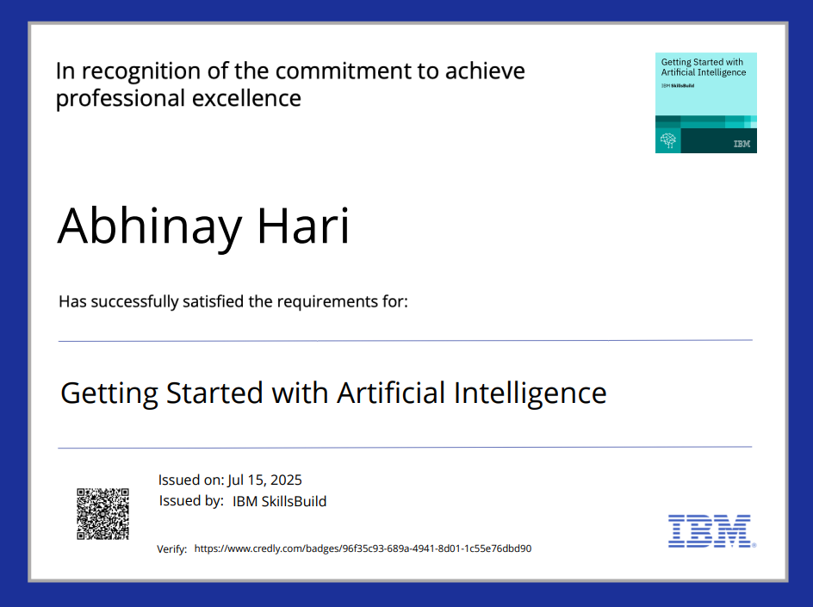
IBM Certifications
Screenshot/ credly certificate( getting started with AI)

Slide 12
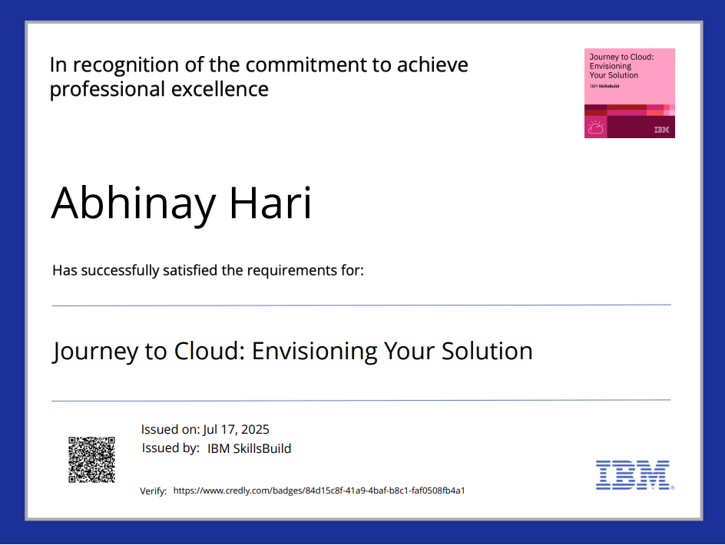
IBM Certifications
Screenshot/ credly certificate( Journey to Cloud)

Slide 13
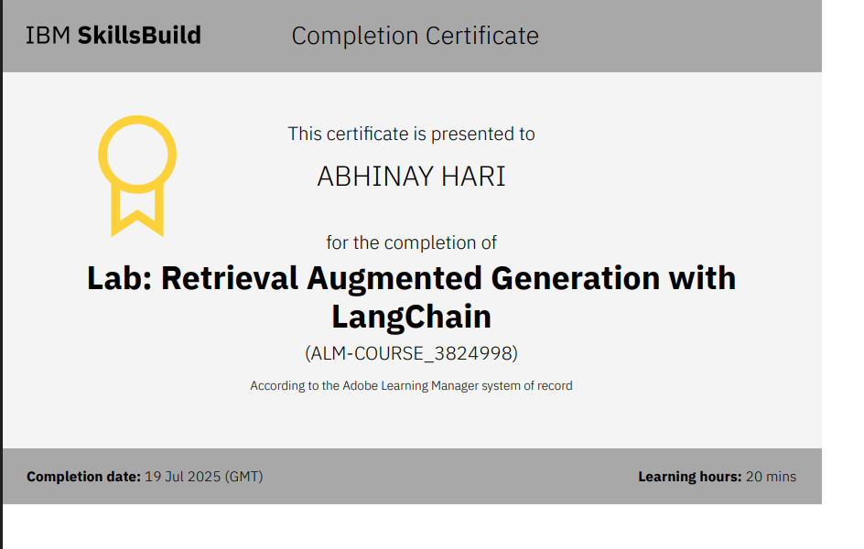
IBM Certifications
Screenshot/ credly certificate( RAG Lab)

Slide 14
THANK YOU

